Slide 1
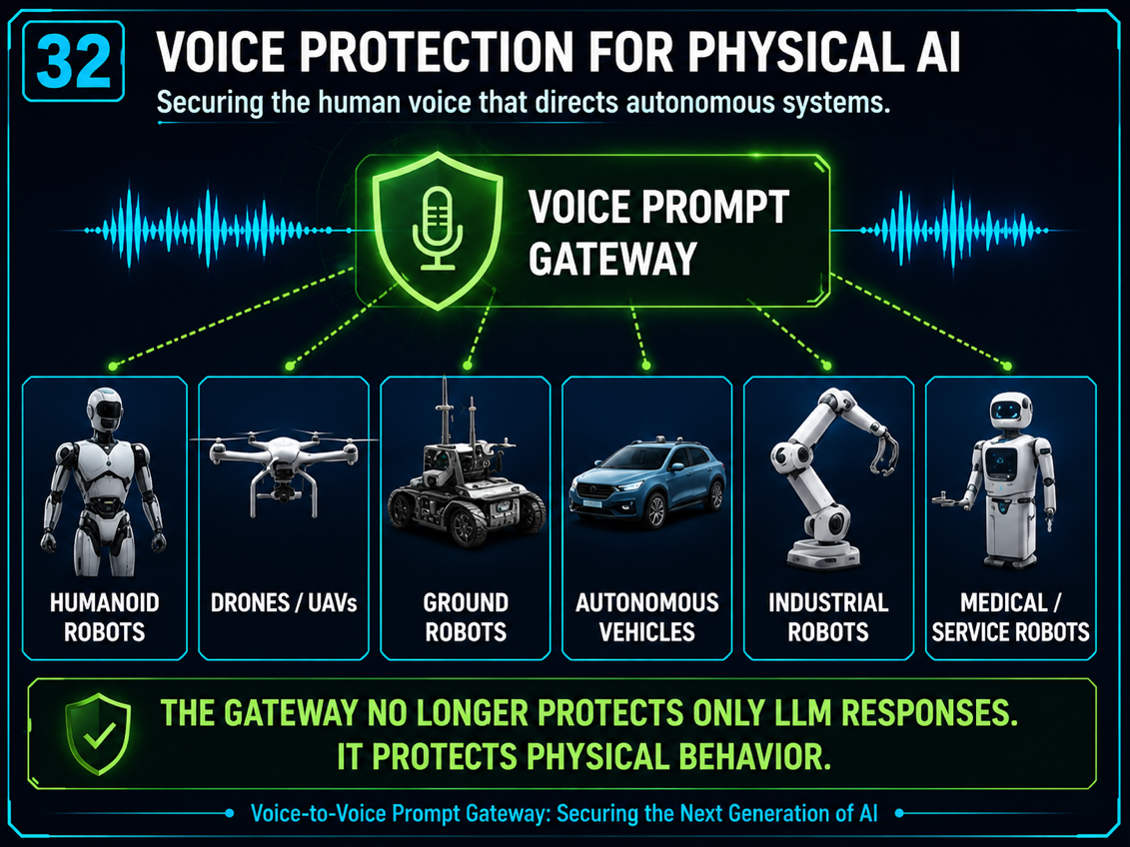


Need: Physical AI will require even more sophisticated Guard Rails
Voice is the next keyboard
Social integration of Physical AI systems with humans will not succeed if these systems cannot interact using natural language
AI Autonomy
Voice Guard Rails will be
Critical for Robot to Human Interaction
Safety, Security, Privacy,
Fraud Prevention, Abuse

Slide 2
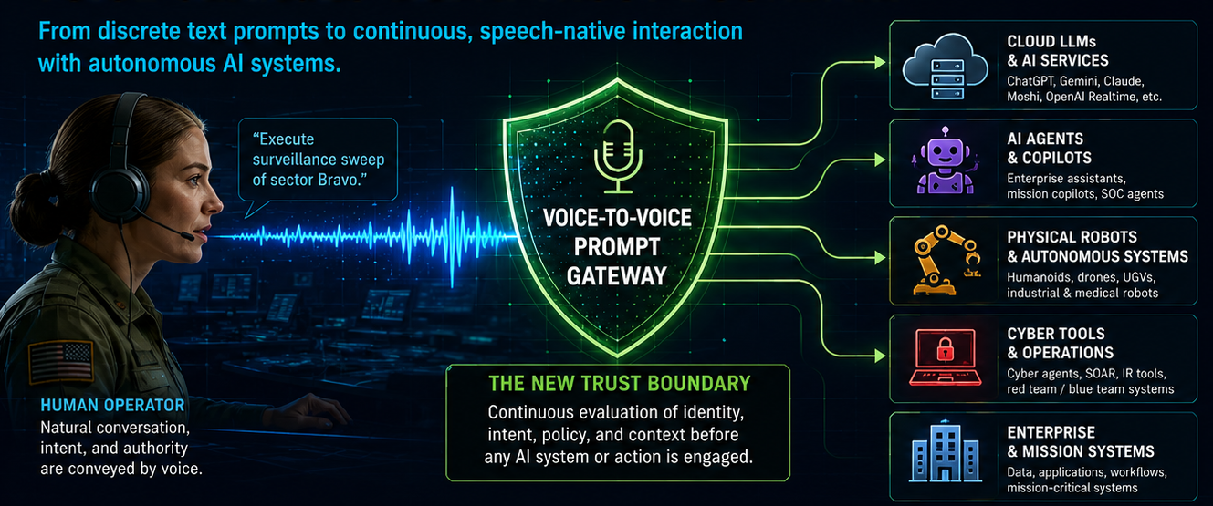






Need: Next-Gen AI-Guard must deal with Conversations, not Prompts
DoD applications that utilize voice interfaces will need to trust that these interfaces will be resilient to attacks
Voice is the Next Mission Attack Surface
Authority & intent
signals
Multi-language and
multi-media encoding
Voice to Semantic
Intent
Background audio &
acoustic injection
Speaker ID and
authentication
Emotional state &
stress indicators

Slide 3
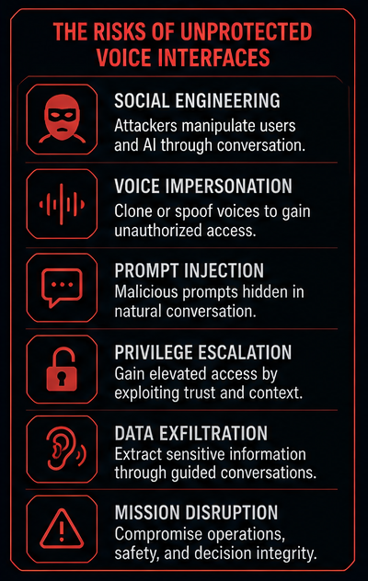
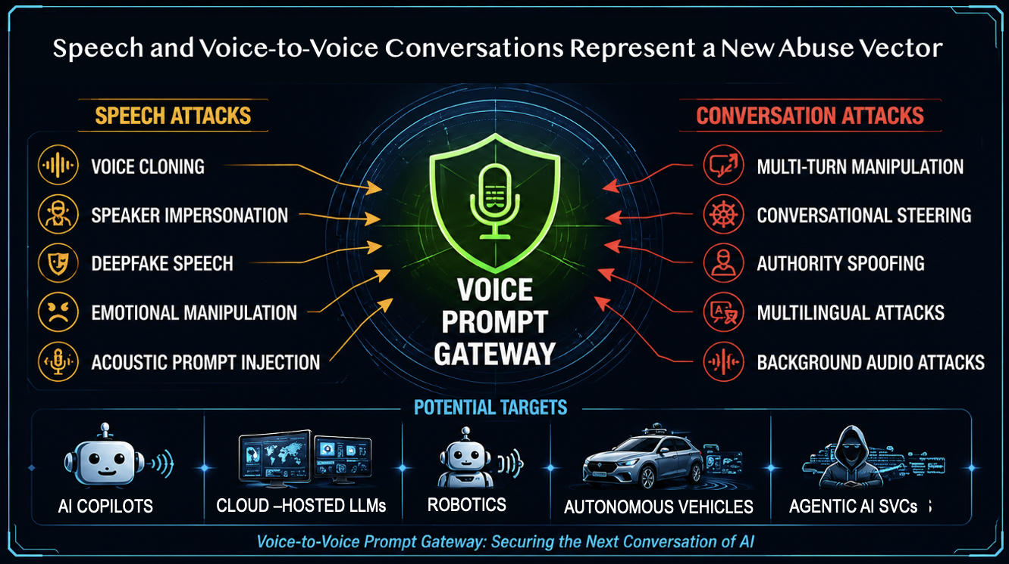
Need: Voice introduces powerful new vectors for manipulation and abuse
Voice introduces powerful new vectors for manipulation and abuse
Examples of attack TTPs – SPEECH BASED and CONVERSATION BASED
What can happen?
How can it happen?

Slide 4
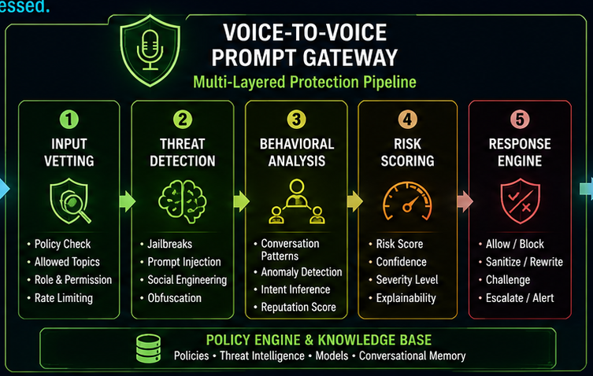
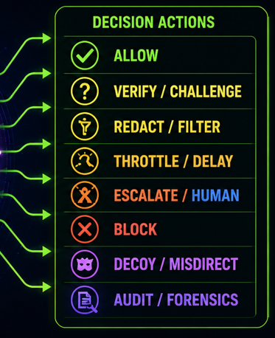
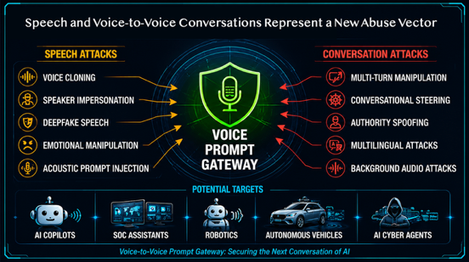
Approach: Next-Gen AI Gateways will Have to Understand Natural Languages
- Our Team Can Rapid Prototype New Assessment Methods -

Slide 5
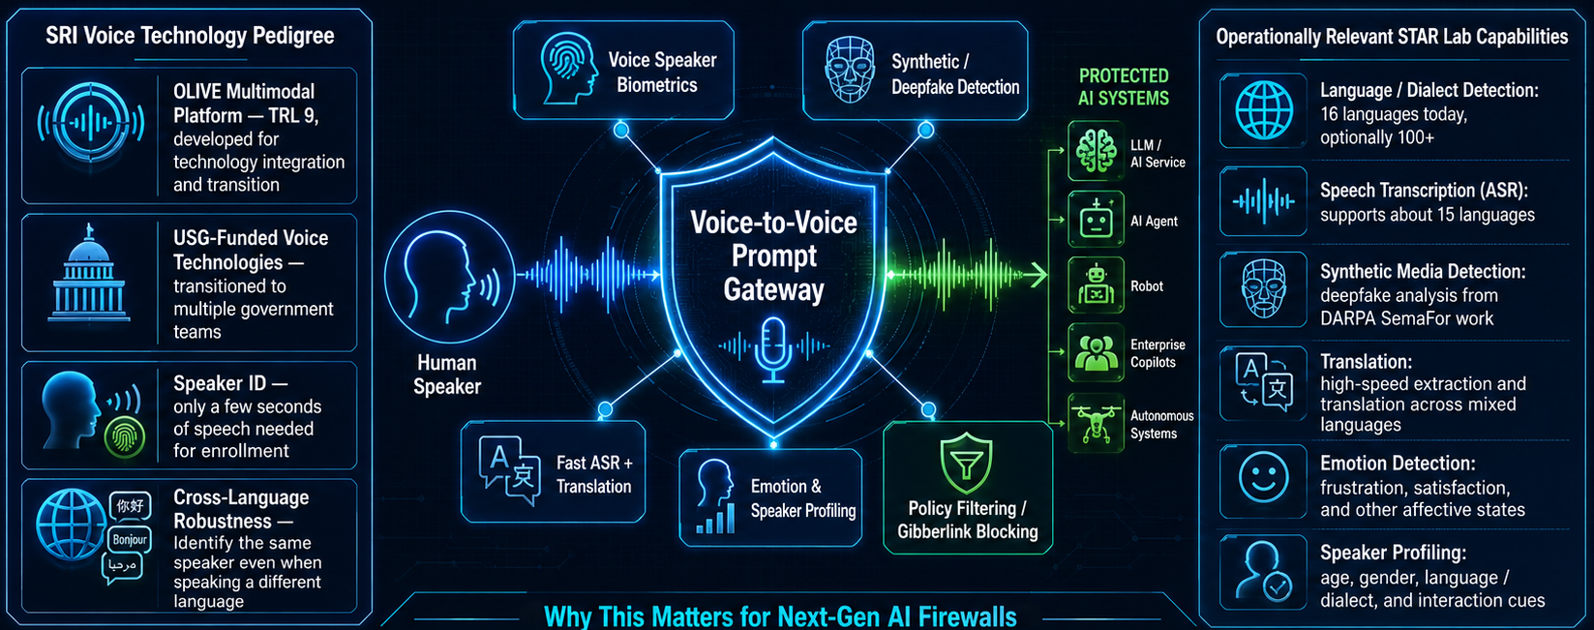
Designing Next-Generation Behavioral
AI Prompt Gateway
AccuKnox Voice-to-Voice AI Prompt Protection
Mature voice Analysis Can Accelerate a Voice-AI gateway

Slide 6
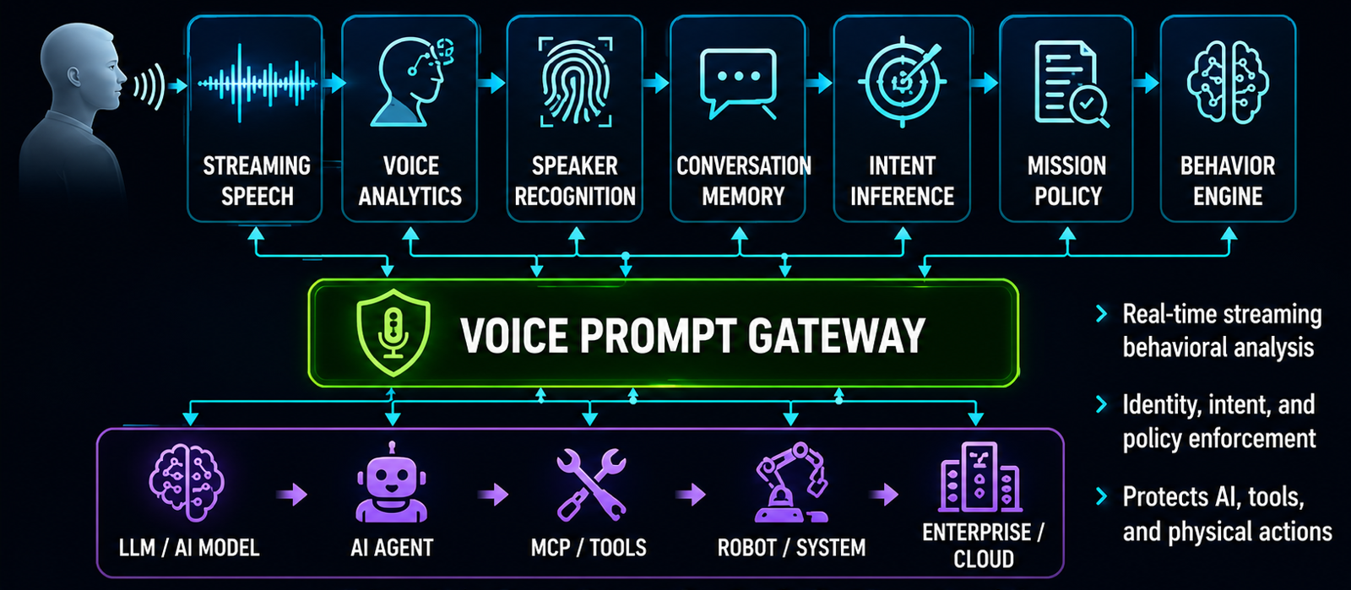
Why is a Voice-to-Voice Gateway Important?
A summary of strategic capabilities that a future SRI voice gateway could deliver across a range of AI services
Future AI protections must be continuous and follow the conversation
– not stateless and prompt based -

Slide 7
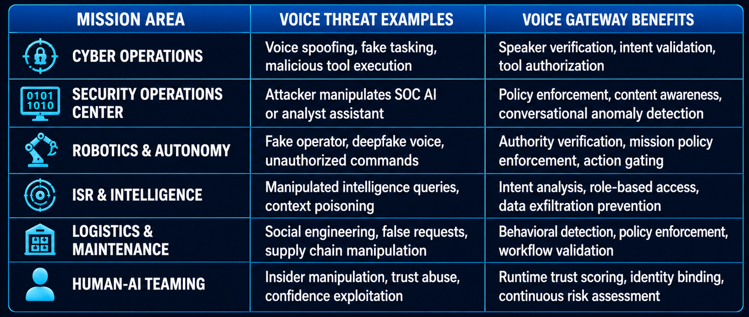
Why? Mission Relevance Across The Future of DoW AI Operations
What are the potential selling points to help DoW realize the value and importance of the voice prompt concept
- Why AccuKnox Clients Should Care-

